Slide 1
DESIGNING BUTTONS
Computing – Faculty of Business, Law and Digital
martin.reid@solent.ac.uk

Slide 2
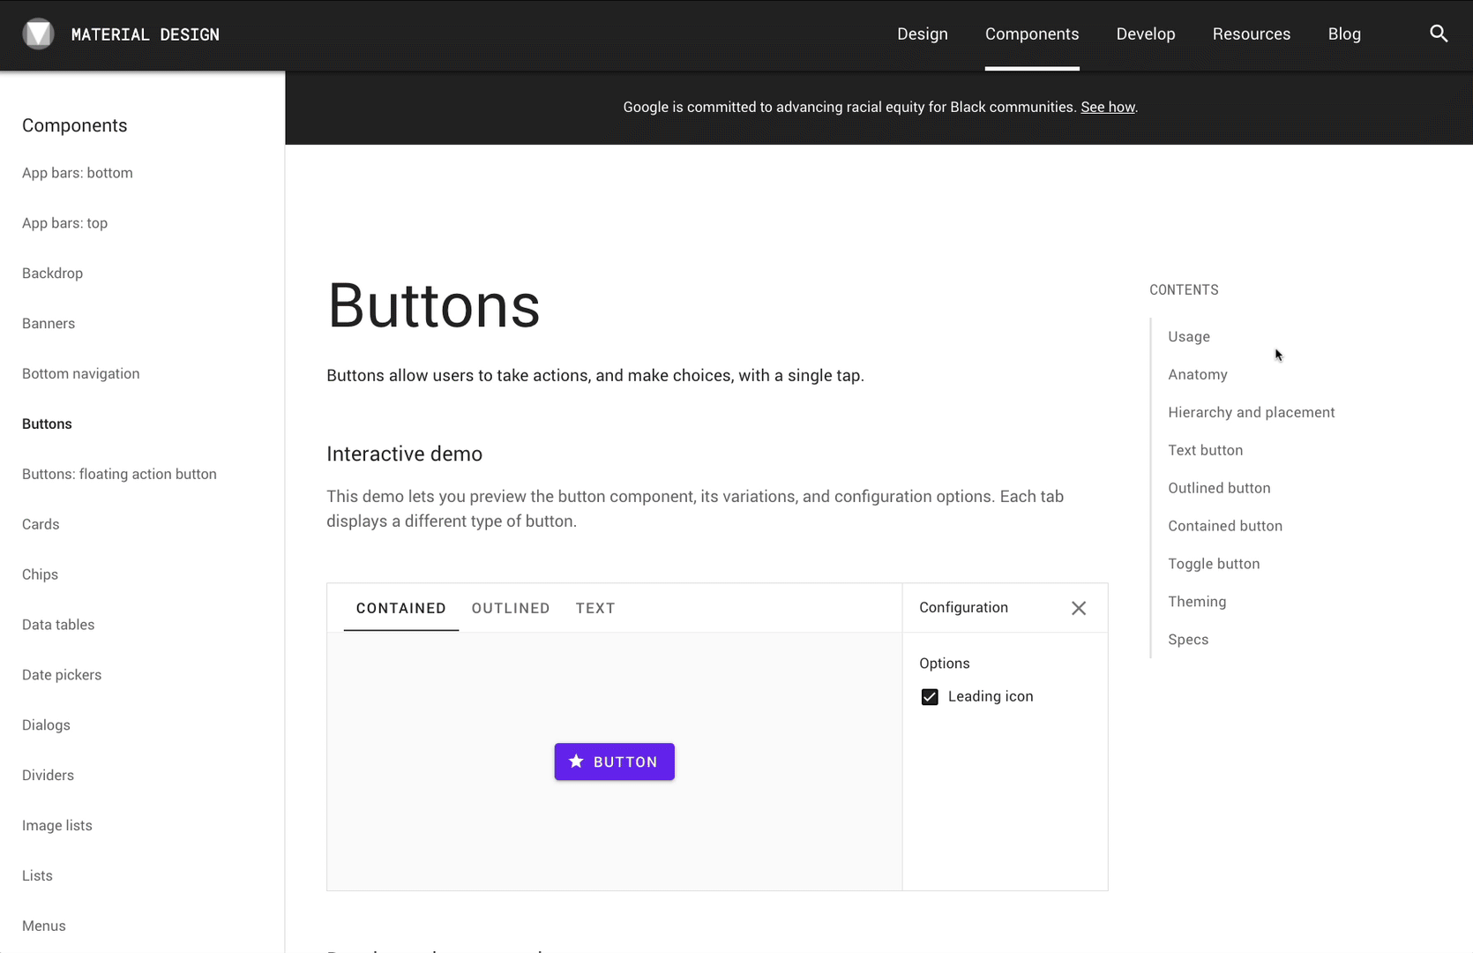
MATERIAL DESIGN, 2020. Material Design [viewed 17 October 2020]. Available from: https://material.io/components/buttons#theming

Slide 3
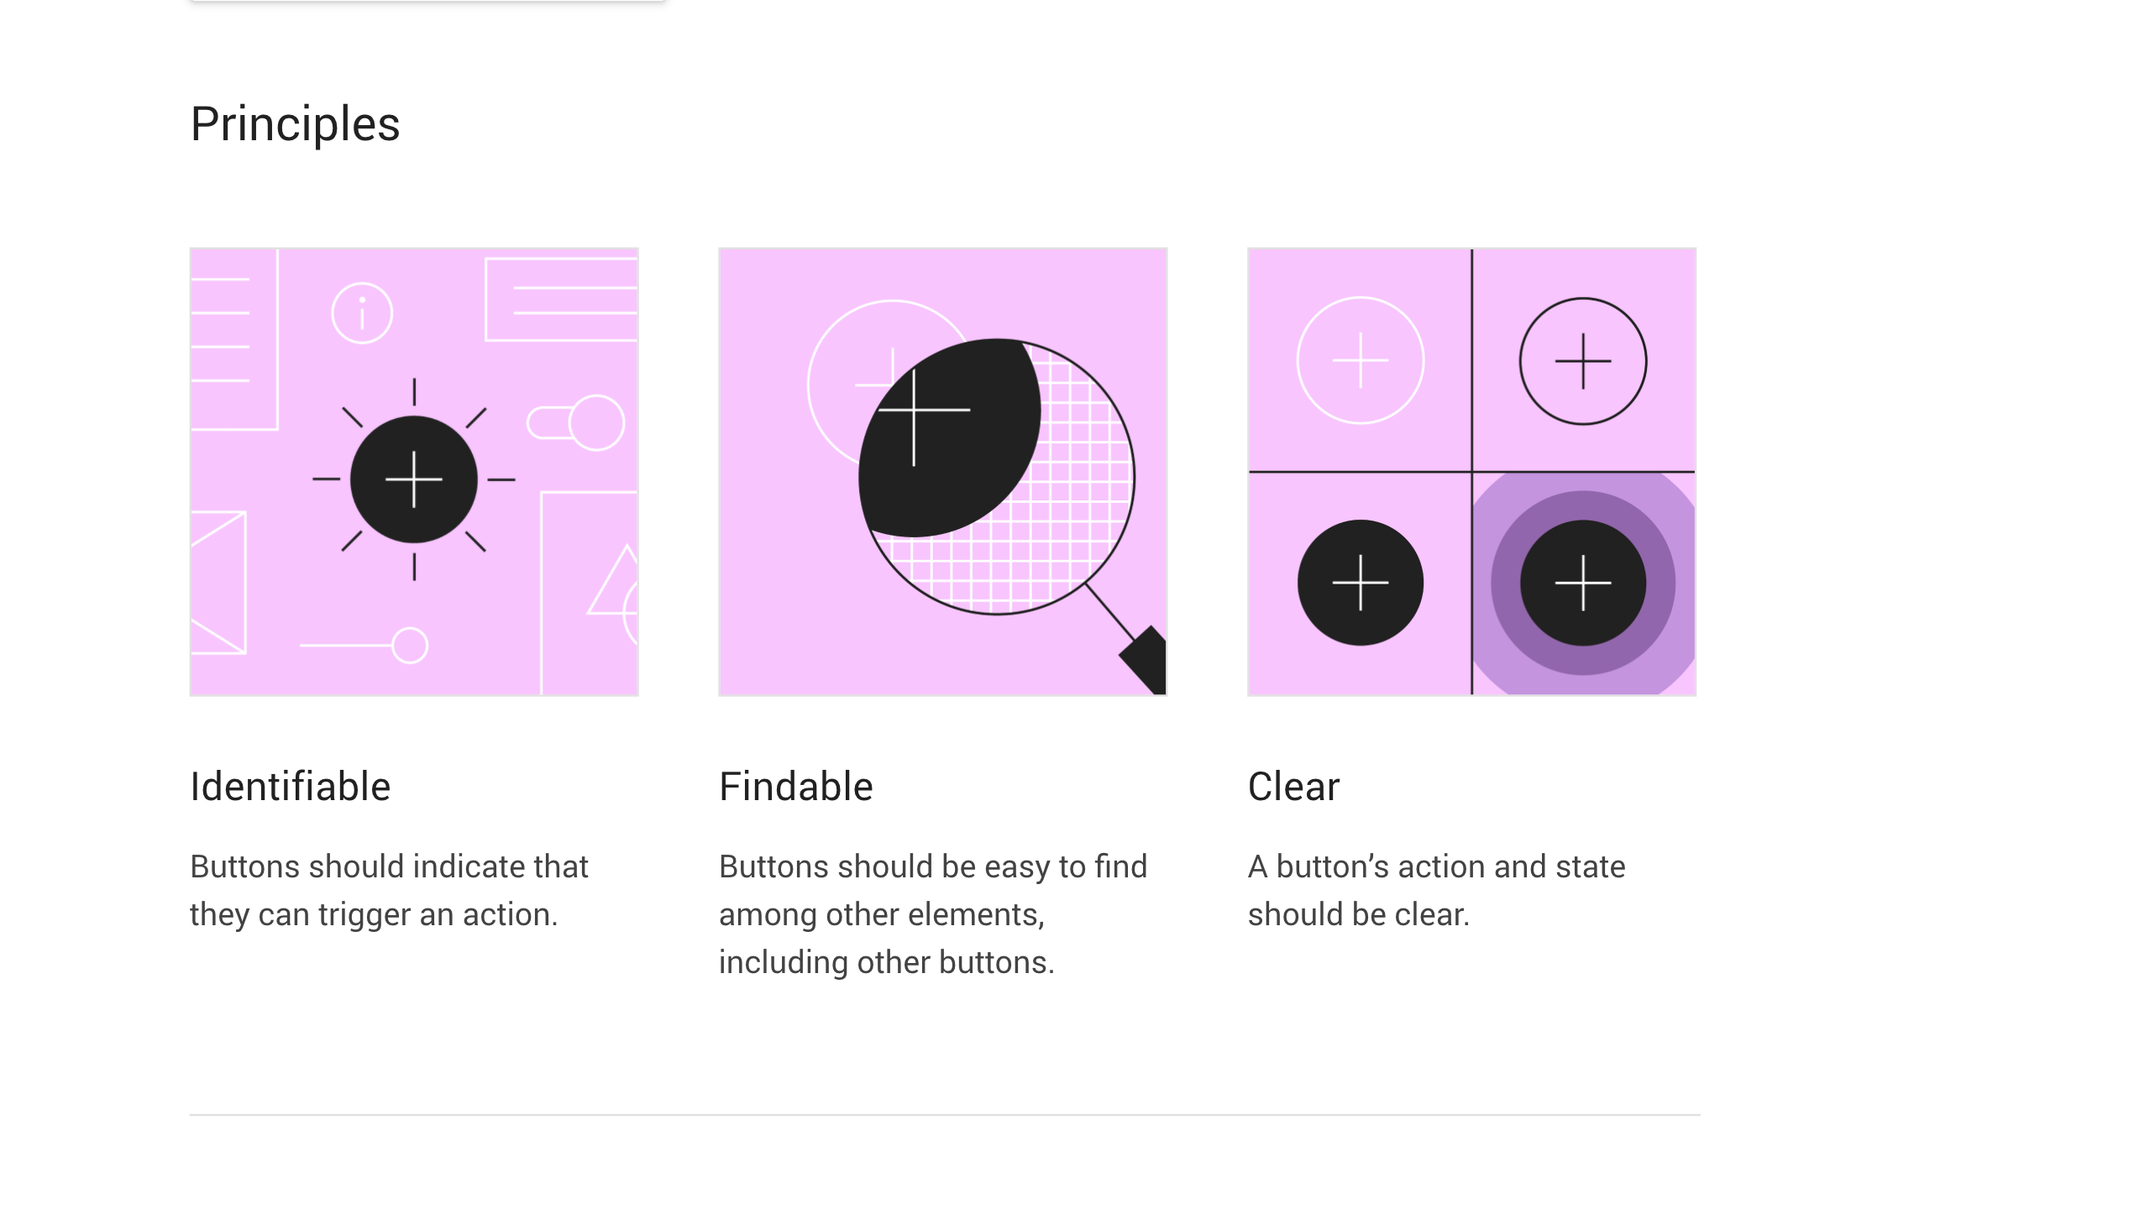

Slide 4
Buttons communicate actions that users can take. They are typically placed throughout your UI, in places like:
Dialogs
Modal windows
Forms
Cards
Toolbars

Slide 5
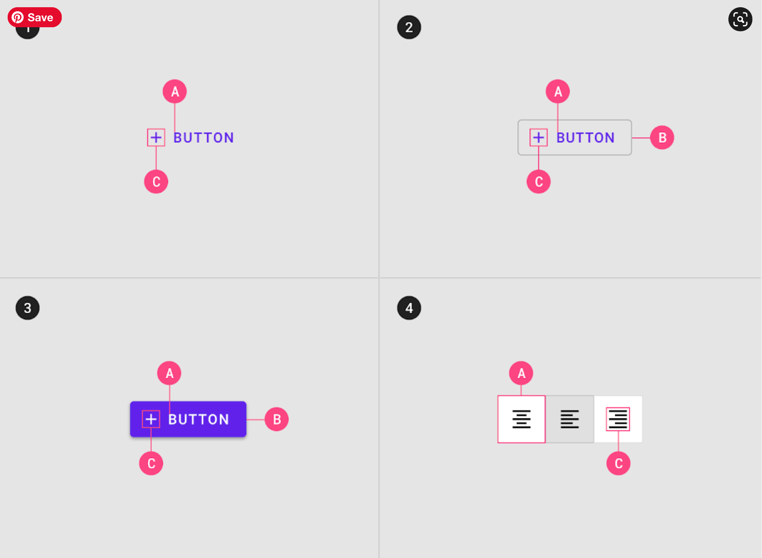
1. Text button (low emphasis) Text buttons are typically used for less important actions. 2. Outlined Button (medium emphasis) Outlined buttons are used for more emphasis than text buttons due to the stroke. 3. Contained button (high emphasis) Contained buttons have more emphasis, as they use a color fill and shadow. 4. Toggle button Toggle buttons group a set of actions using layout and spacing. They’re used less often than other button types.
1. Text button A. Text label C. Icon (optional) 2. Outlined button A. Text label B. Container C. Icon (optional) 3. Contained button A. Text label B. Container C. Icon (optional) 4. Outlined button A. Text label C. Icon (optional)
https://material.io/components/buttons

Slide 6
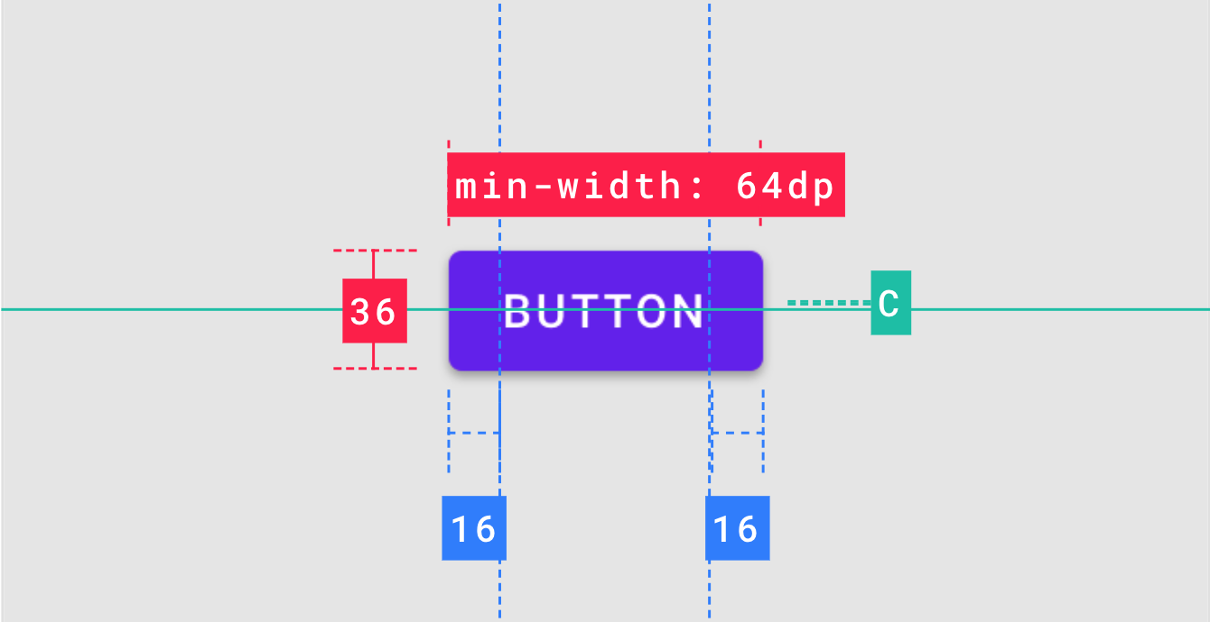
https://material.io/components/buttons

Slide 7
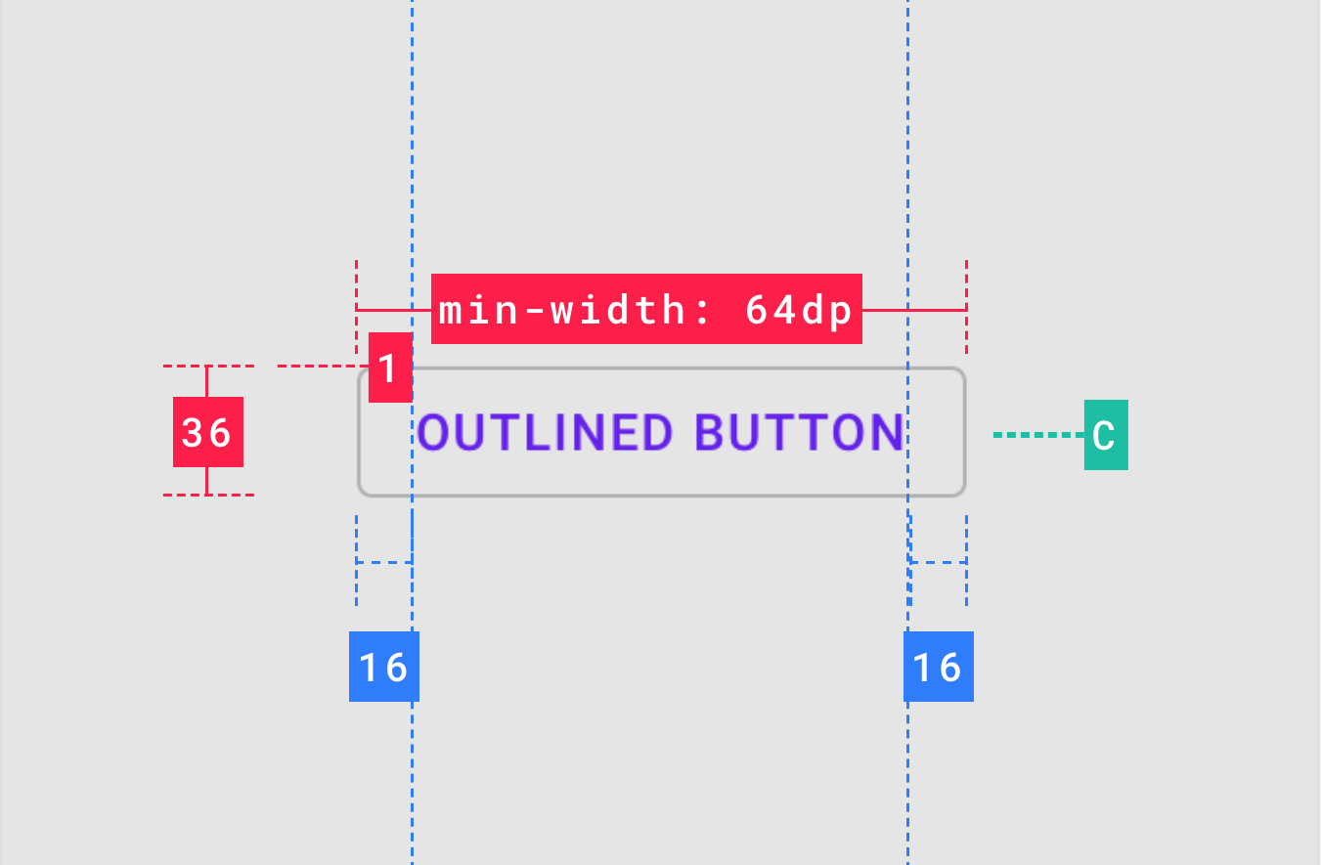
https://material.io/components/buttons

Slide 8
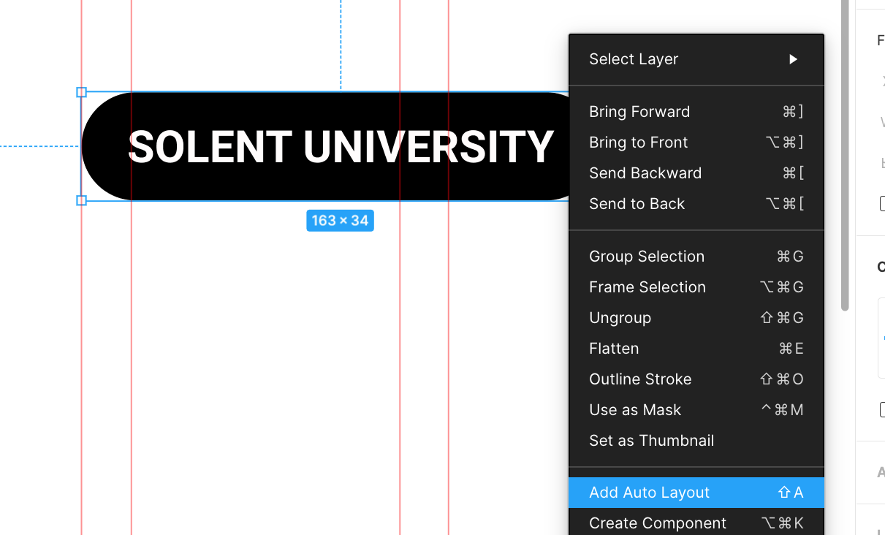

Slide 9
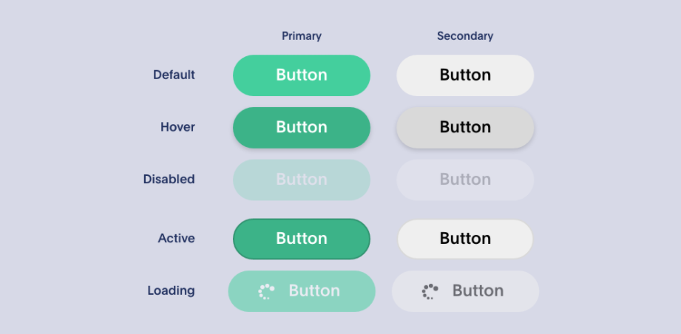
https://xd.adobe.com/ideas/process/ui-design/designing-interactive-buttons-states/

Slide 10
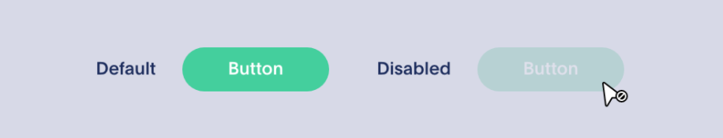
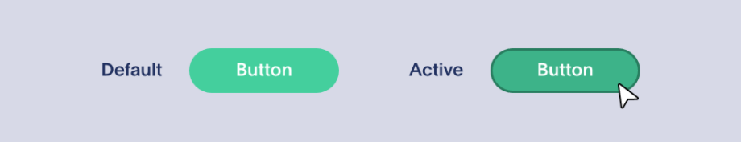
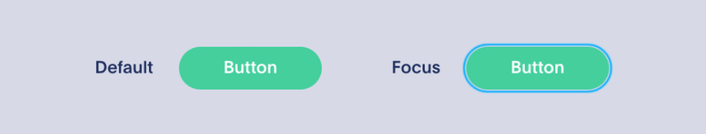
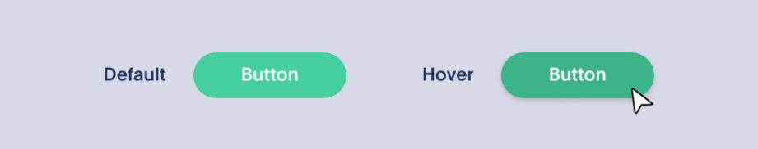
https://xd.adobe.com/ideas/process/ui-design/designing-interactive-buttons-states/

Slide 11
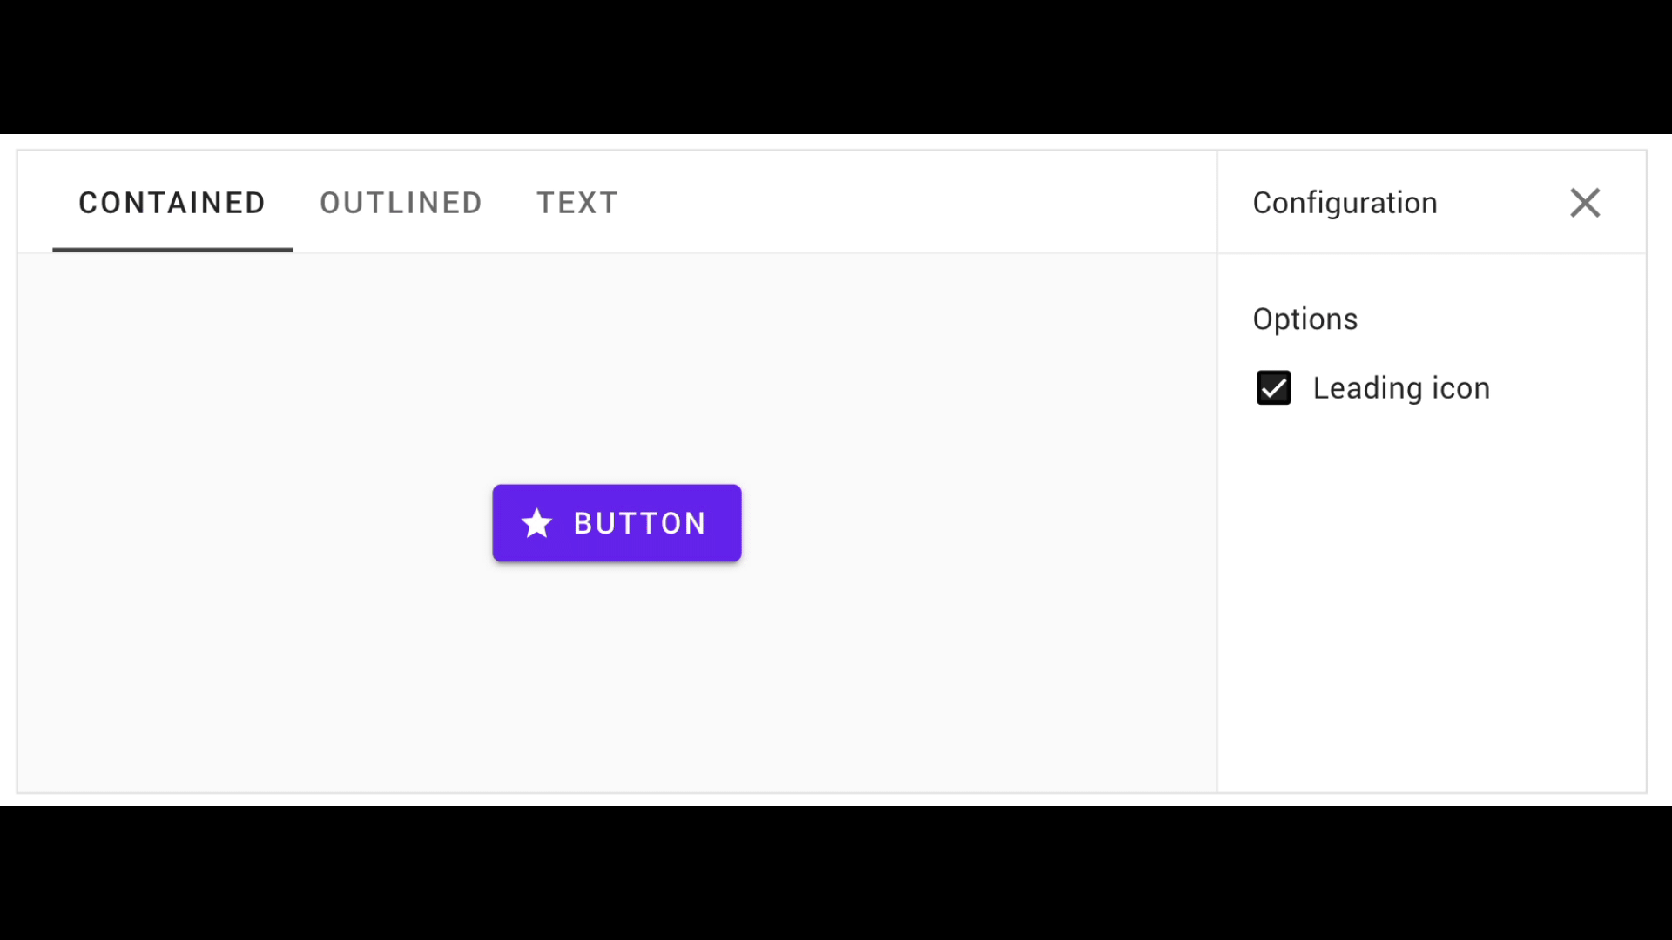

Slide 12
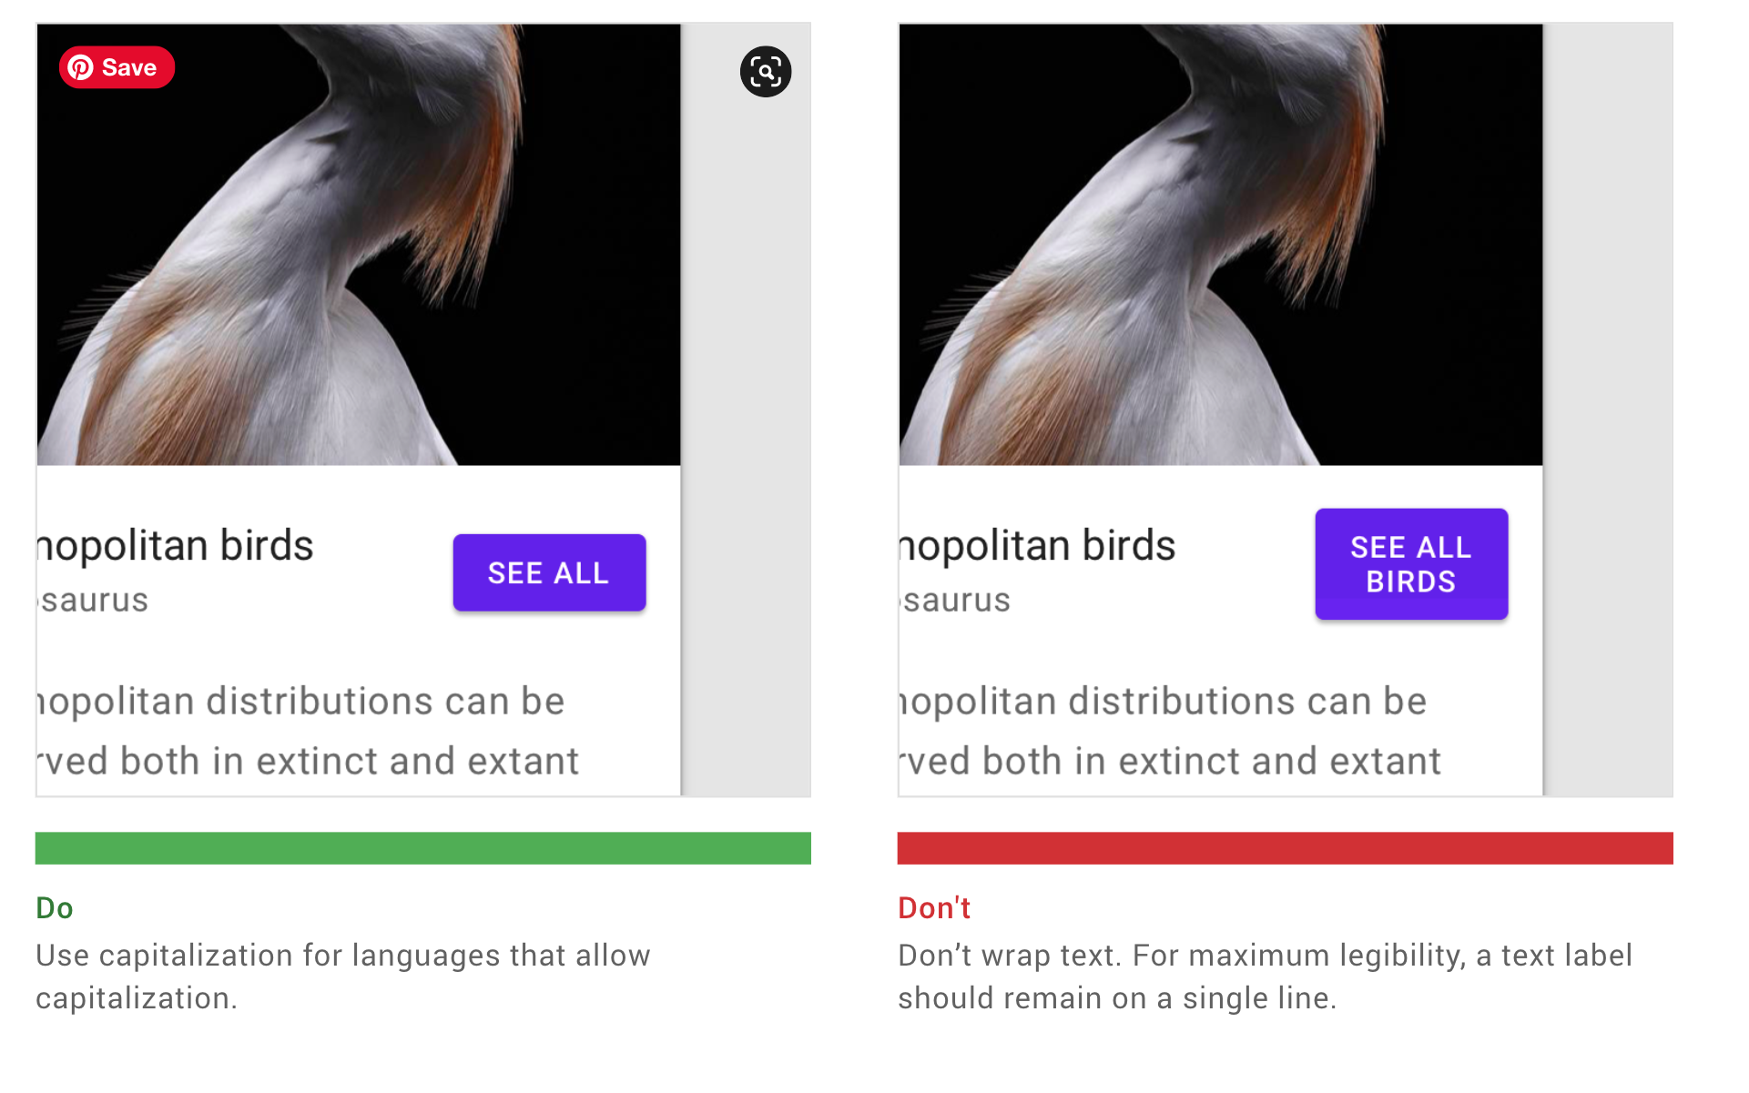

Slide 13
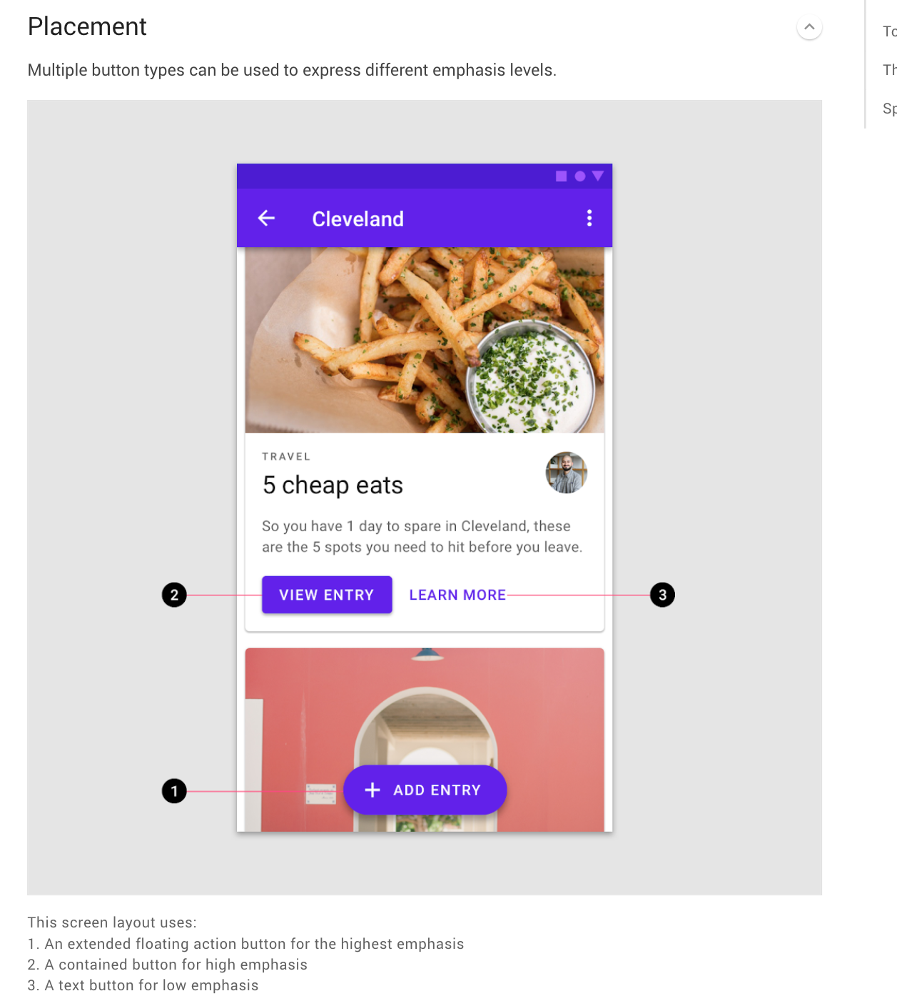

Slide 14
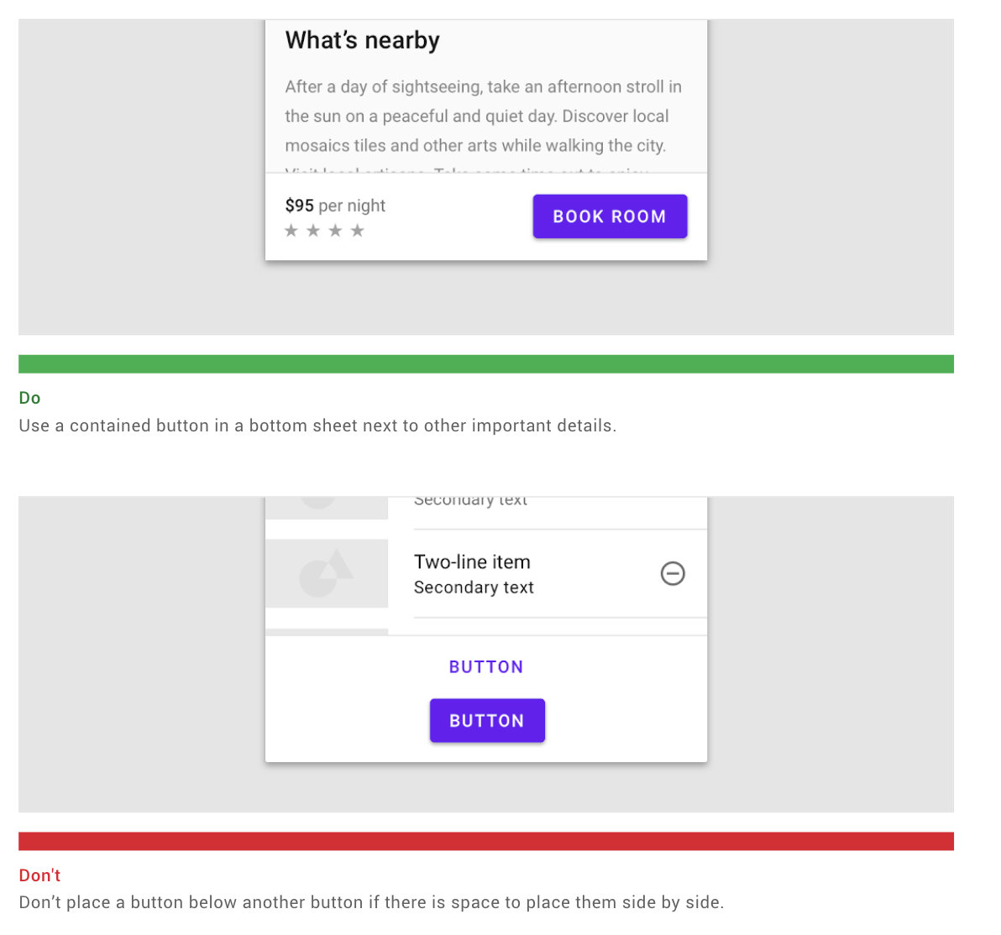

Slide 15
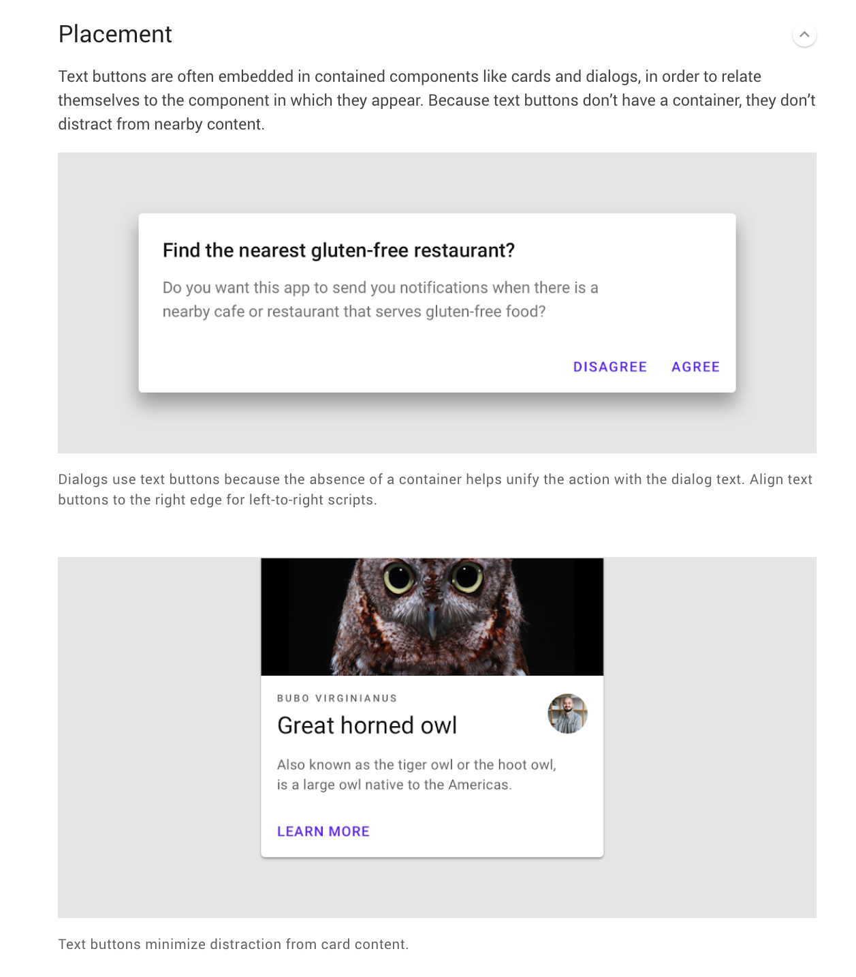

Slide 16
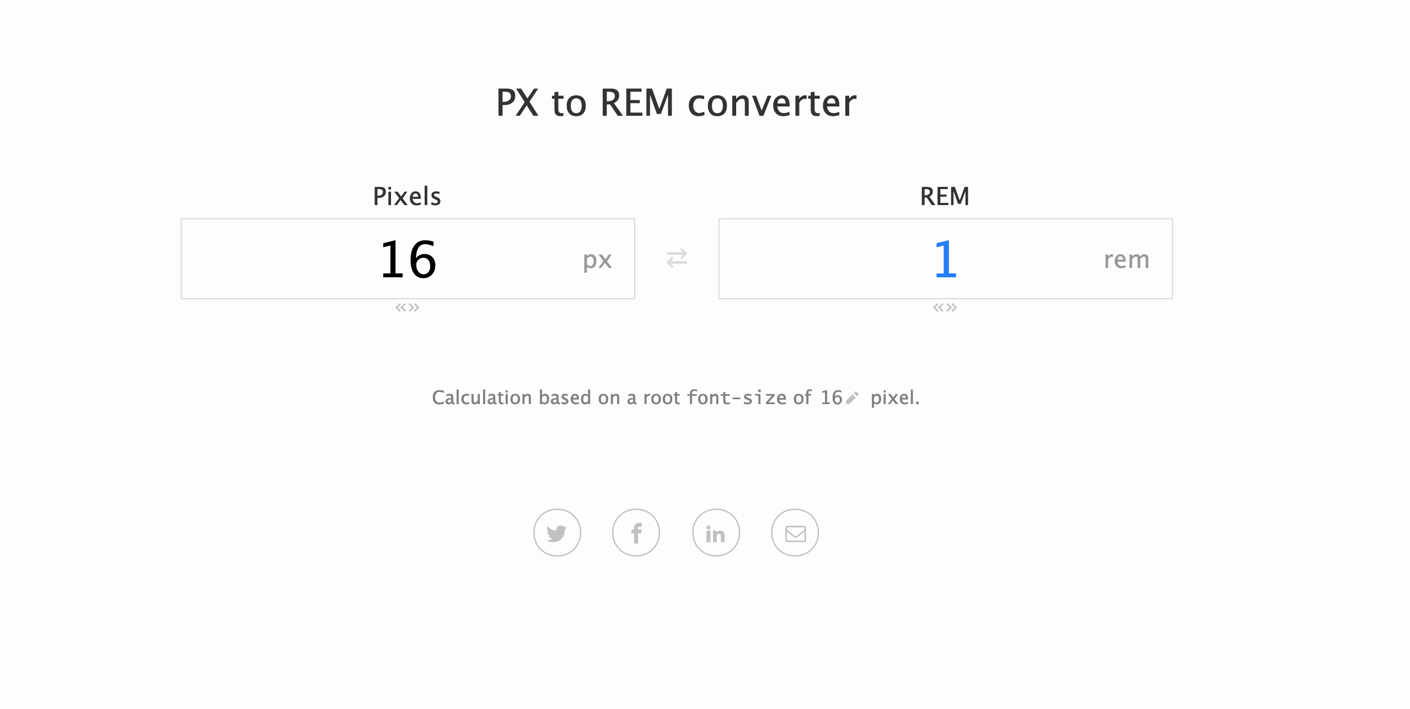
https://nekocalc.com/px-to-rem-converter

Slide 17
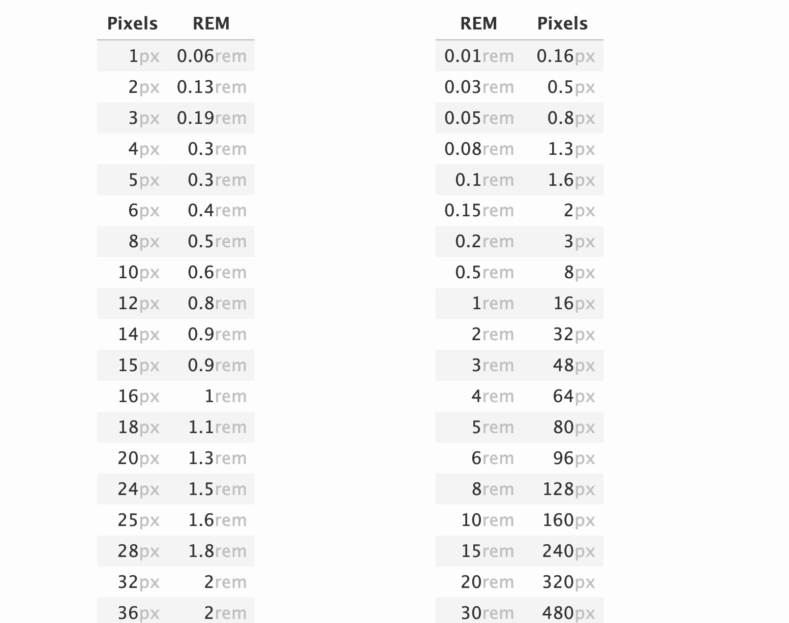

Slide 18
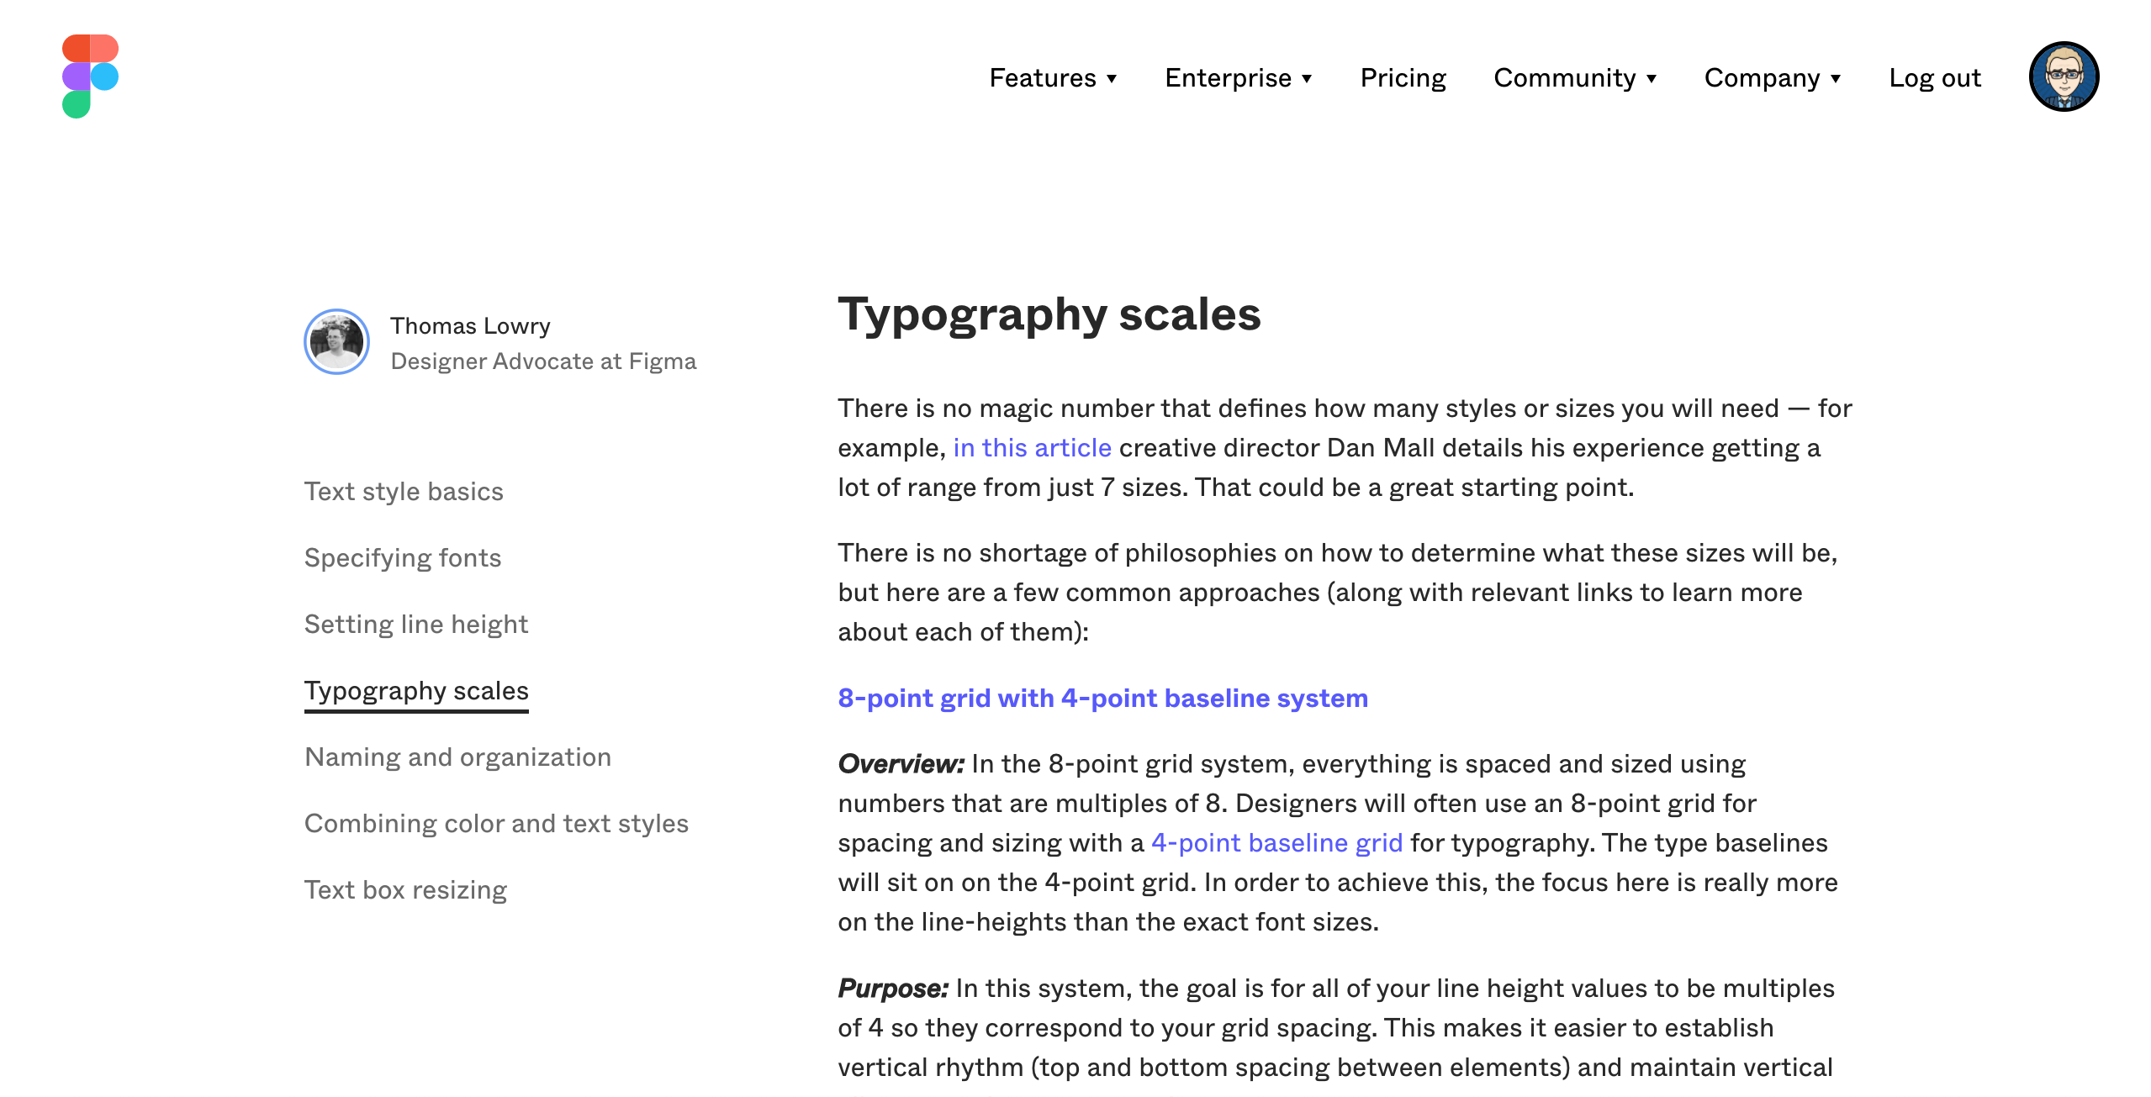
https://www.figma.com/best-practices/typography-systems-in-figma/typography-scales/

Slide 19
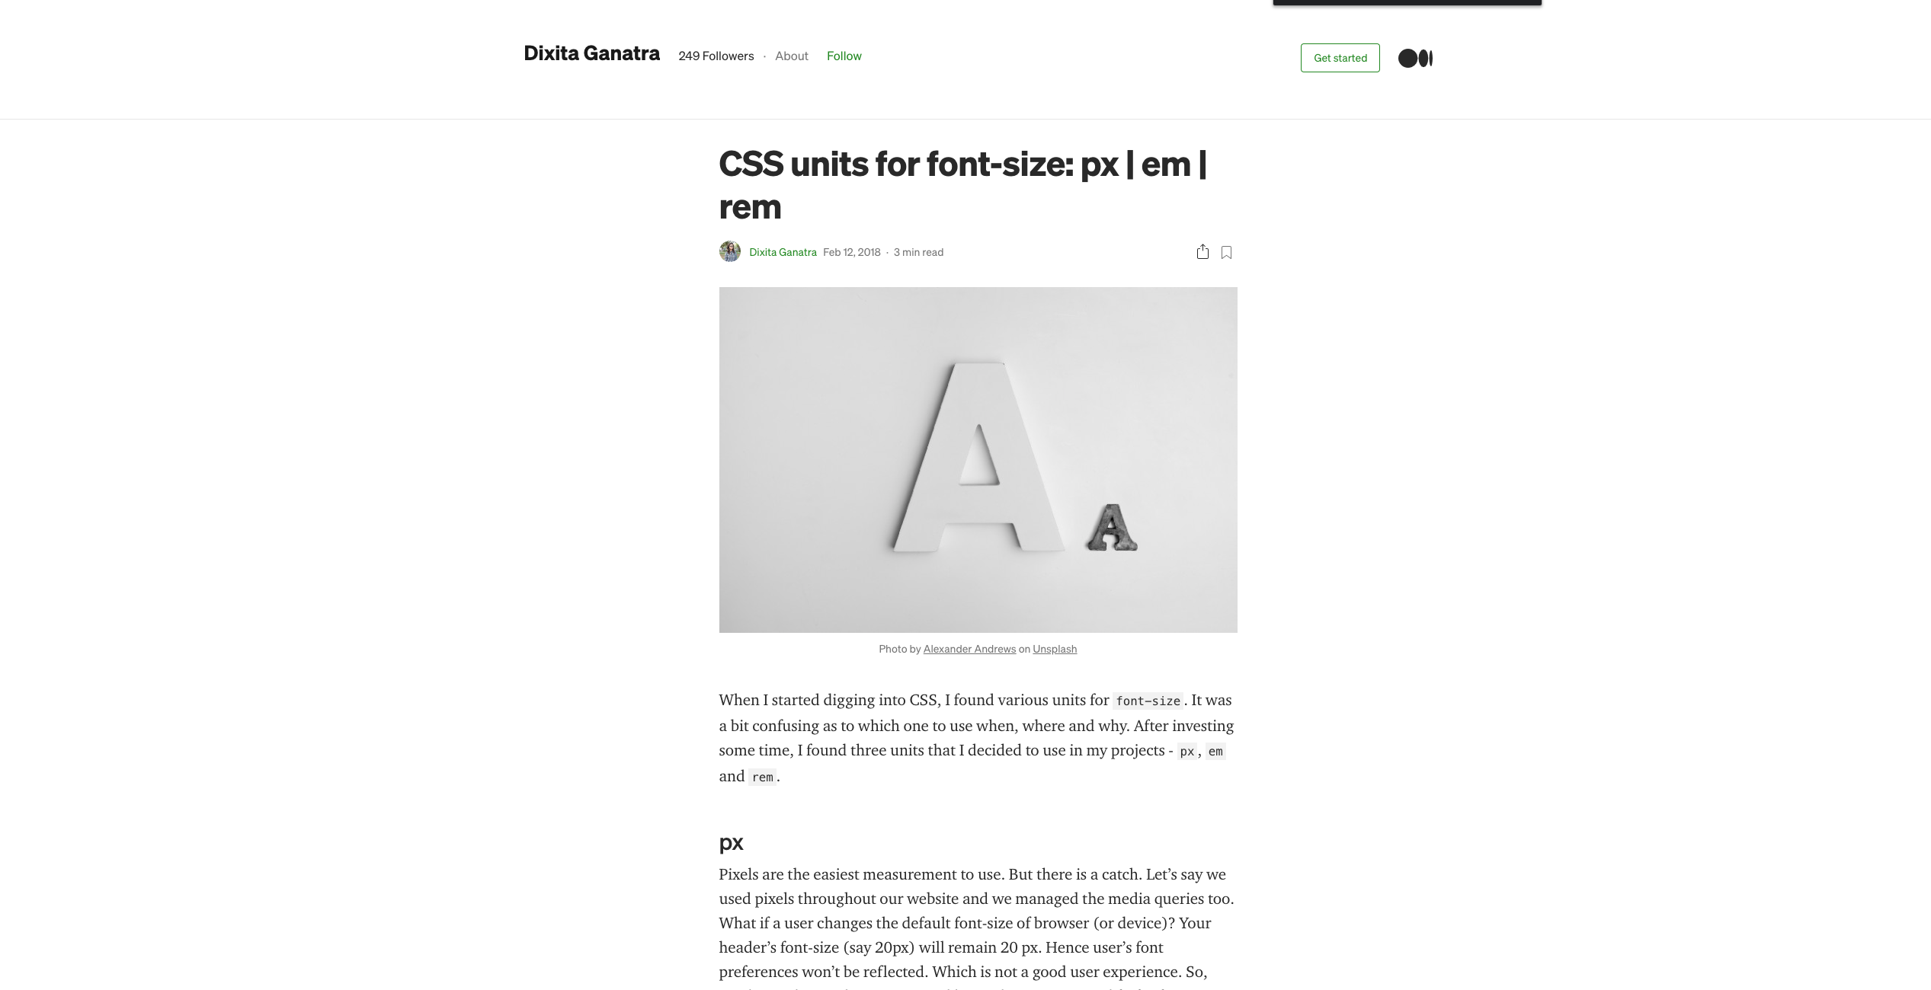
https://medium.com/code-better/css-units-for-font-size-px-em-rem-79f7e592bb97

Slide 20
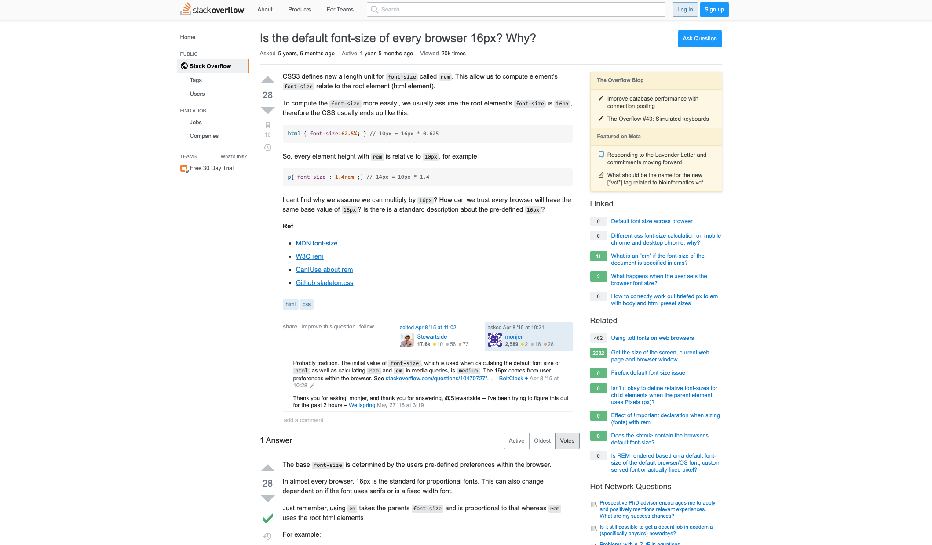
https://stackoverflow.com/questions/29511983/is-the-default-font-size-of-every-browser-16px-why

Slide 21
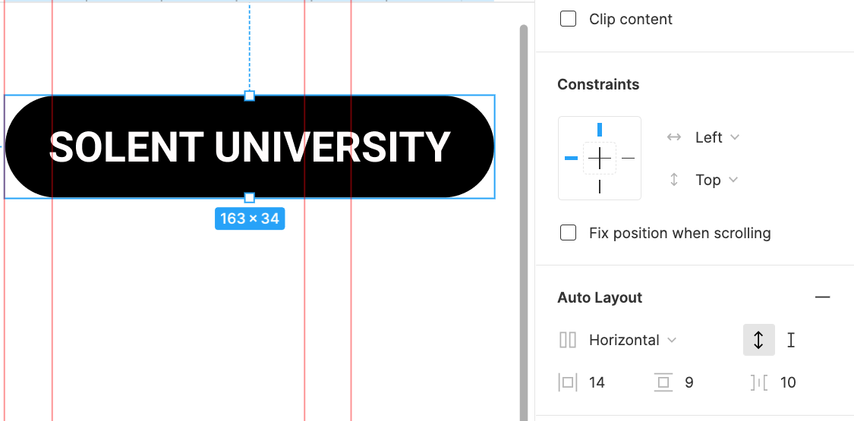

Slide 22
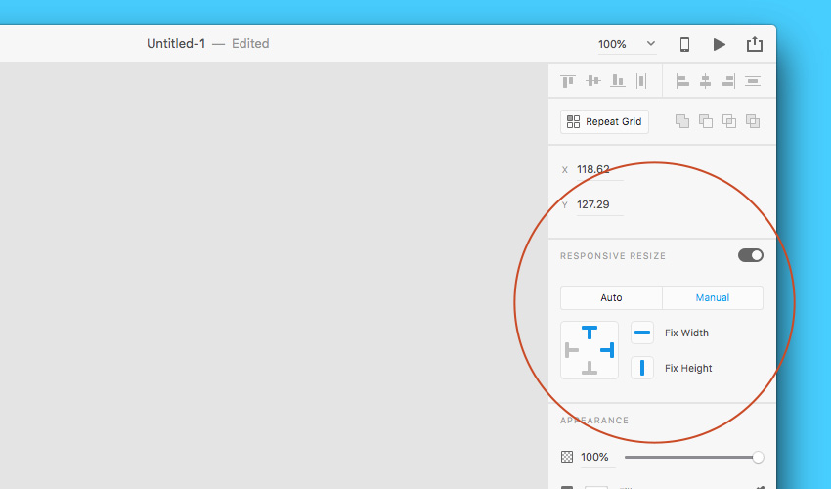
https://helpx.adobe.com/xd/user-guide.html/xd/help/using-responsive-resize.ug.html

Slide 23
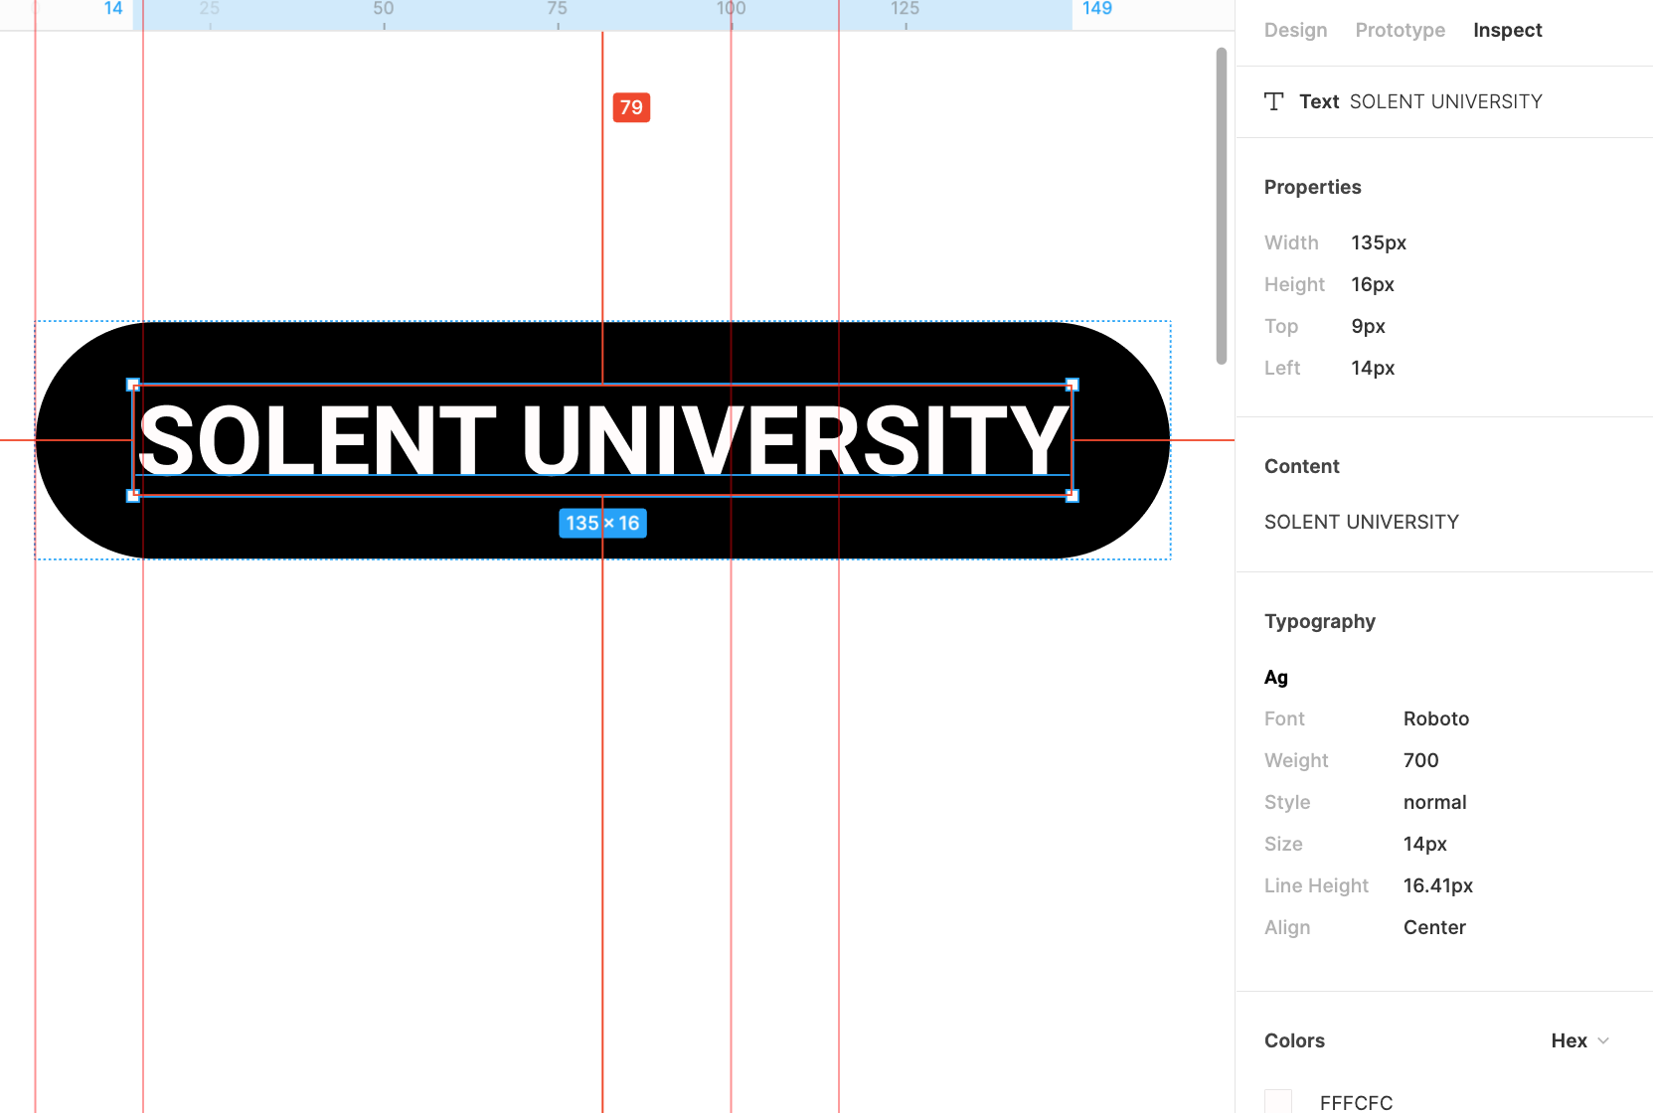

Slide 24
